Slide 1
Chapter 3 Finite Markov Decision Processes
Intro to Reinforcement Learning
By Richard Sutton
12/9/19

Slide 2
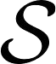

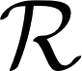
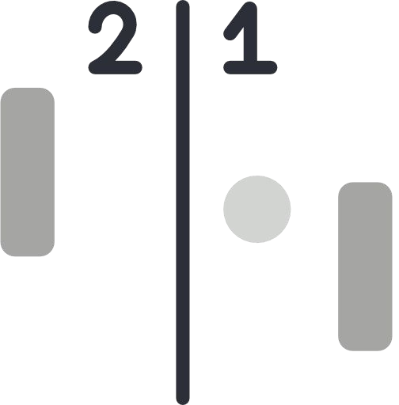


Markov Decision Process (MDP)
Simplified, flexible reinforcement learning problem
Consists of States , Actions , Rewards
States
Info available to agent
Actions
Choice made by agent
Rewards
Basis for evaluating choices
Notes:
MDPs is classical formalization of sequential decision making which are a mathematically idealized form of RL.
In a finite MDP, the sets of states, actions, and rewards (S, A, and R) all have a finite
number of elements.
In this case, the random variables Rt and St have well defined
discrete probability distributions dependent only on the preceding state and action

Slide 3


Agent
Environment
The learner
Takes action
Everything outside the agent
Returns state and reward
Notes:
MDPs are meant to be a straightforward framing of the problem of learning from interaction to achieve a goal.

Slide 4





3.1 Agent-Environment Boundary
Anything the agent cannot arbitrarily change is part of the environment
Agent might still know everything about the environment
Different boundaries for different purposes
“Brain”
Machinery
Sensors
Battery

Slide 5
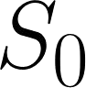
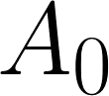
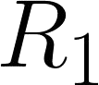
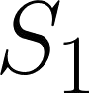
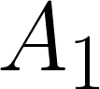
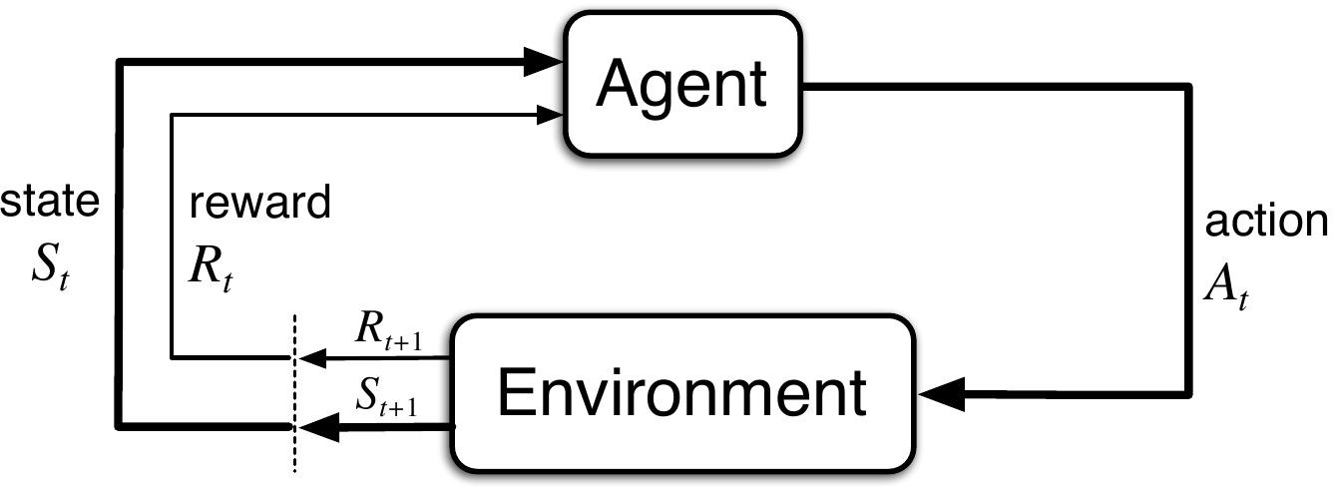
Agent-Environment Interactions
Agent observes a state
Agent takes action
Agent receives reward
Agent takes another action
Repeat
and new state
Notes:
In a finite MDP, the sets of states, actions, and rewards (S, A, and R) all have a finite number of elements.
In this case, the random variables Rt and St have well defined discrete probability distributions dependent only on the preceding state and action

Slide 6
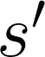
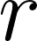
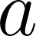
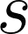
Transition Probability
Probability of reaching state and reward by taking action
Fully describes the dynamics of a finite MDP
on state
Can infer other properties of the environment
Notes:
What is the probability of being in the next state and obtaining a reward by taking an action on the current state

Slide 7
Expected Rewards
Expected reward of taking action
on state
Expected reward of arriving in state
by taking action
on state

Slide 8
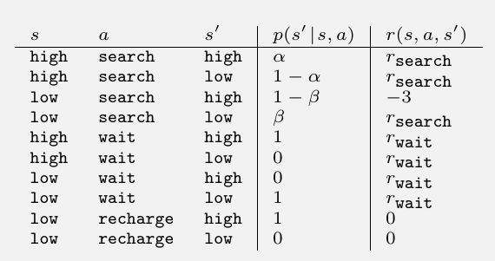
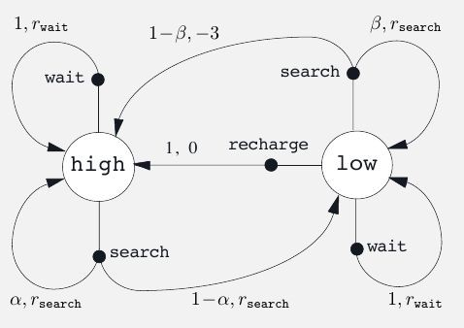
Recycling Robot Example
States: Battery status (high or low)
Actions
Search: High reward. Battery status can be lowered or depleted.
Wait: Low reward. Battery status does not change.
Recharge: No reward. Battery status changed to high.
If battery is depleted, -3 reward and battery status changed to high.
Transition Probabilities & Expected Rewards Table
Transition Graph
Graphical summary of MDP dynamics
Transition Graph

Slide 9



3.2 Designing Rewards
Reward hypothesis
Goals and purposes can be represented by maximization of cumulative reward
Tell what you want to achieve, not how
Always -1
Proportional to forward action
+1 for each box

Slide 10
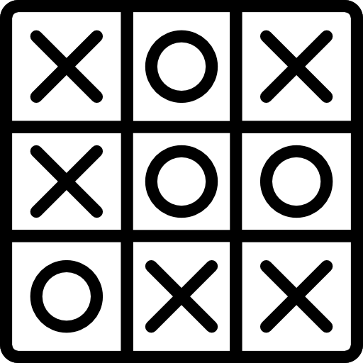
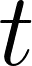
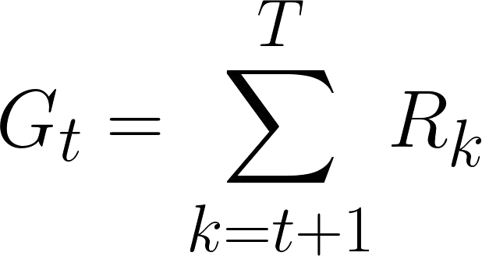
3.3 Episodic Tasks
Interactions can be broken into episodes
Episodes end in a special terminal state
Each episode is independent
Finished when the game ends
Finished when the agent is out of the maze
Return for Episodic Tasks
Sum of rewards from time step
Time of termination:
Notes:
G vs Q/q =

Slide 11

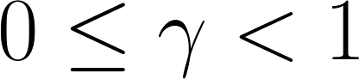
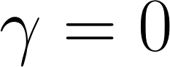
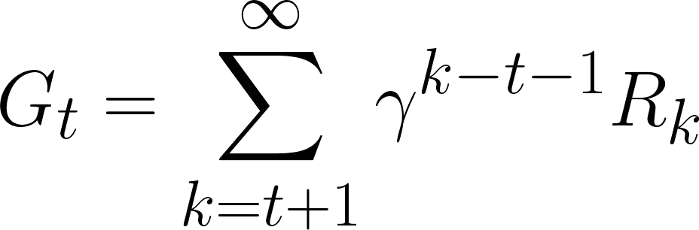
Continuing Tasks
Cannot be naturally broken into episodes
Goes on without limit (no terminal state)
The agent keeps running until we have to stop him.
Stock Trading
Return for Continuing Tasks
Sum of rewards is almost always infinite
Need to discount future rewards by factor
If , the return only considers immediate reward (myopic)

Slide 12
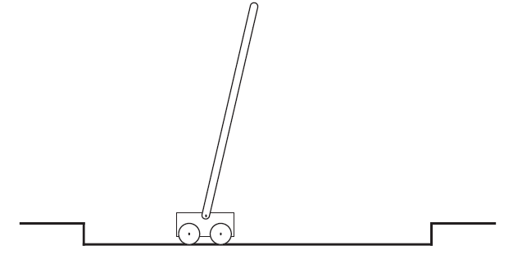
Pole-Balancing Example
Objective: The objective in this task is to apply forces to a cart moving along a track so as to keep a pole hinged to the cart from falling over.
Reward: The reward in this case could be +1 for every time step on which failure did not occur, so that the return at each time would be the number of steps until failure.

Slide 13
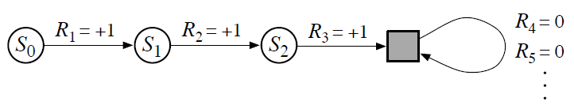
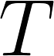
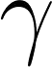
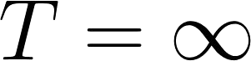
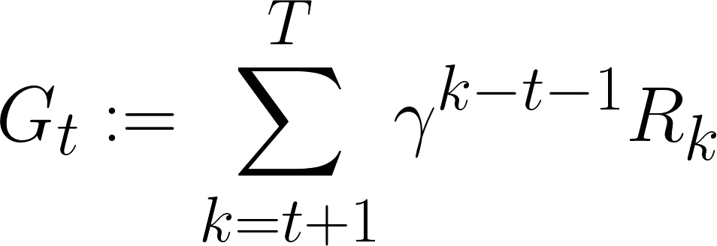
3.4 Unified Notation for Return
Cumulative reward
can be a finite number or infinity
Future rewards can be discounted with factor
If , then must be less than 1.

Slide 14
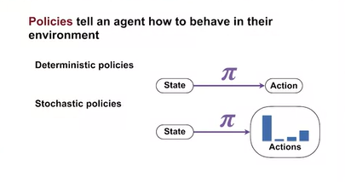
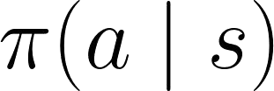


3.5 Policy
Deterministic: Mapping from states to probabilities of selecting each possible action
Stochastic: Probability of selecting action in
state

Slide 15
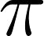
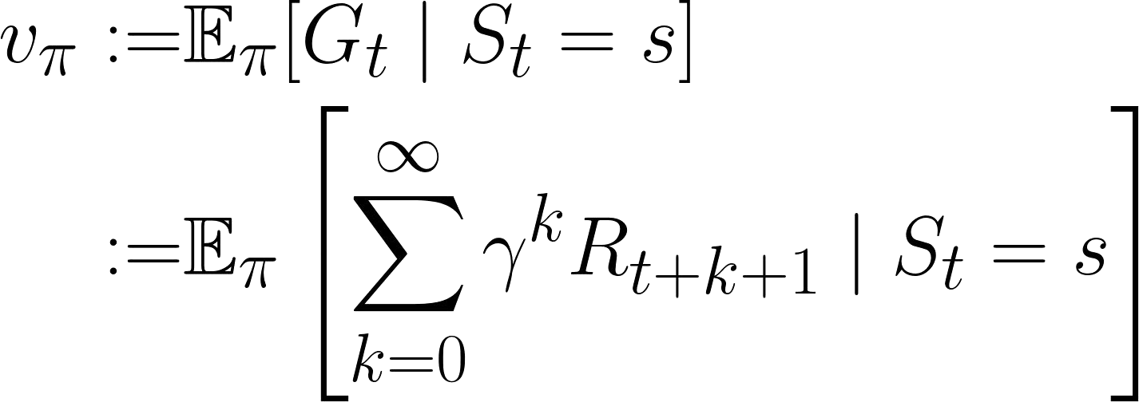
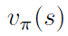
State-value function for policy
Expected return from state
and following policy , and t is any time step
Notes:
Estimate future return under a particular policy.
State Value fnc gives the expected return for the current state under a policy.

Slide 16
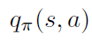
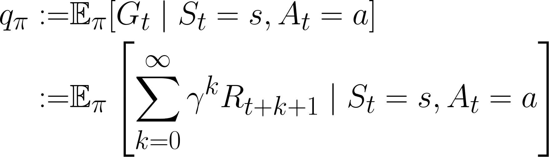
Action-value function for policy
Expected return from taking action
in state
and following policy
Notes:
Action Value fnc gives the expected return from state S if the agent first selects action A under and follows Pi after that.

Slide 17
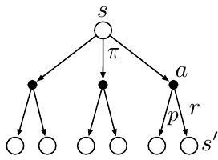
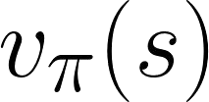
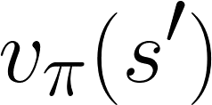
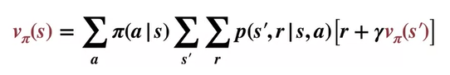
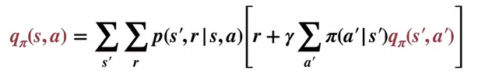
Bellman Equation
State value function
Recursive relationship between
and
Backup Diagram
Action value function
The Bellman equation averages over all the possibilities, weighting each by its probability of occurring
Notes:
The Bellman Equation for the state value function gives the value of the current state as a sum over the values of all the successor states and immediate rewards
The Bellman Equation for the action value function gives the value of a particular state-action pair as a sum over the values of all the possible next state-action pairs and rewards
This Bellman equations help us evaluate policies but not to find the ‘optimal’ policies… this is done by using the Bellman Optimality equations (next slide)

Slide 18
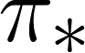
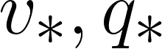
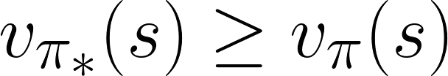
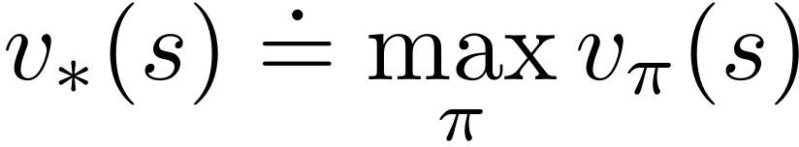
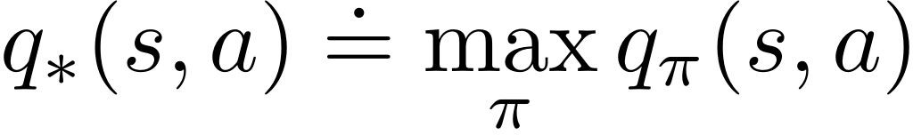
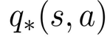
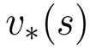
3.6 Optimal Policies
and Value Functions
for all states
For any policy ,
There can be multiple optimal policies
All optimal policies share same optimal value functions:
in terms of :

Slide 19
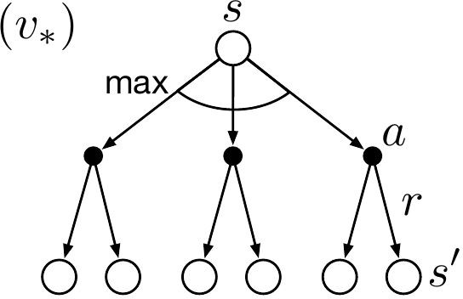
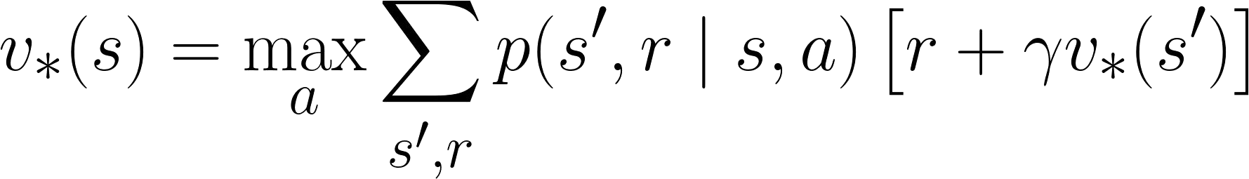
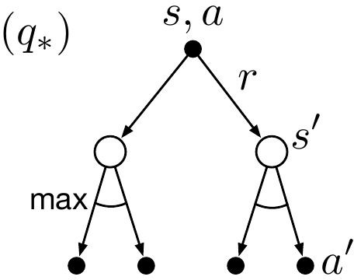
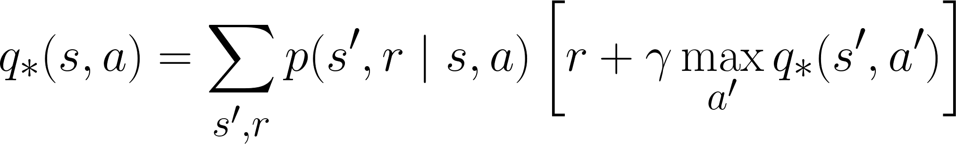
Bellman Optimality Equation
The Bellman optimality equation expresses the fact that the value of a state under an optimal policy must equal the expected return for the best action from that state
Bellman Equation for optimal policies
Notes:
Backup diagrams
Arcs have been added at the agent’s choice points to represent that the maximum over that choice is taken rather than the expected value given some policy

Slide 20


Solving Bellman Optimality Equation
Linear system: equations, unknowns
Possible to find the exact optimal policy
Impractical in most environments
Need to know the dynamics of the environment
Need extreme computational power
Need Markov property
Finding Optimal Policy when Given Value Function
→ In most cases, approximation is the best possible solution.
Notes:
For example, although the first and third assumptions present no problems for the game of backgammon, the second is a major impediment.
Because the game has about 10^20 states, it would take thousands of years on today’s fastest computers to solve the Bellman equation for v⇤, and the same is true for finding q⇤.

Slide 21



3.7 Approximation
Does not require complete knowledge of environment
Less memory and computational power needed
Can focus learning on frequently encountered states

Slide 22
References
Reinforcement Learning: An Introduction by Sutton and Barto
Reinforcement-learning-an-introduction-chapter-3

